Slide 1








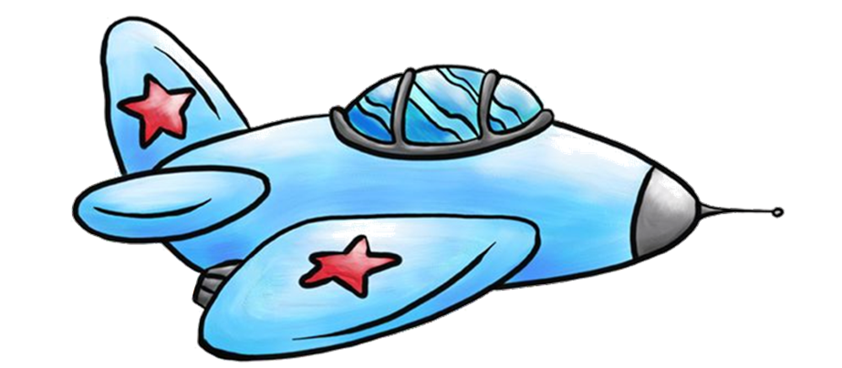



Start

Slide 2






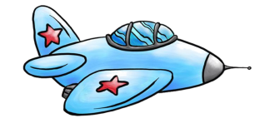



||
Score: 026

Slide 3




OPTIONS
X
Music
On
Effects
Off
Vibrate
On
Difficulty
normal
Start

Slide 4

||
Score: 014
Pause
X
HARD score 26
Music
Off
Effects
Off
Vibrate
On
Menu

Slide 5
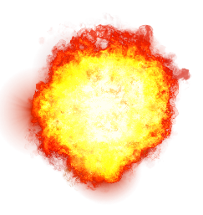


||
GAME OVER
Score: 042
EASY
score
42
best score
69

Slide 6


||
Don’t fly to high
Score: 026
Pause the game here
Check your score here
Hold screen and jet will go up
Turbo is limited, fly far to increase turbo bar
Don’t touch the bombs
Release screen and jet will go down
Don’t fly to low
Press turbo to fly faster

